Slide 1

A Project Presentation
On
Diabetes Prediction System with K-Nearest Neighbors (KNN) Algorithm
Submitted By
Piyush Sthapit (41002140)
A Final Project Presentation Submitted in partial fulfillment of the requirement of Bachelor in Computer Applications(BCA) 6th semester of Tribhuvan University, Nepal
April, 2026 A.D.

Slide 2
Introduction to project
This project analyzes patient health data and predict diabetes risk, helping with early detection and preventive healthcare.
K-Nearest Neighbors (KNN) Algorithm is used to classify patient health data into high-risk and low-risk categories for diabetes, ensuring accurate risk assessment and reliable medical recommendations..
Built with Streamlit, Python, Scikit-learn, and JSON for a fast, user-friendly, and smooth diabetes risk assessment experience.

Slide 3
Objective of the Project
To classify diabetes risk assessment using machine learning to classify patients into high-risk and low-risk categories for timely intervention and recommend doctors accordingly.
To store and display prediction history for patients and healthcare providers.

Slide 4
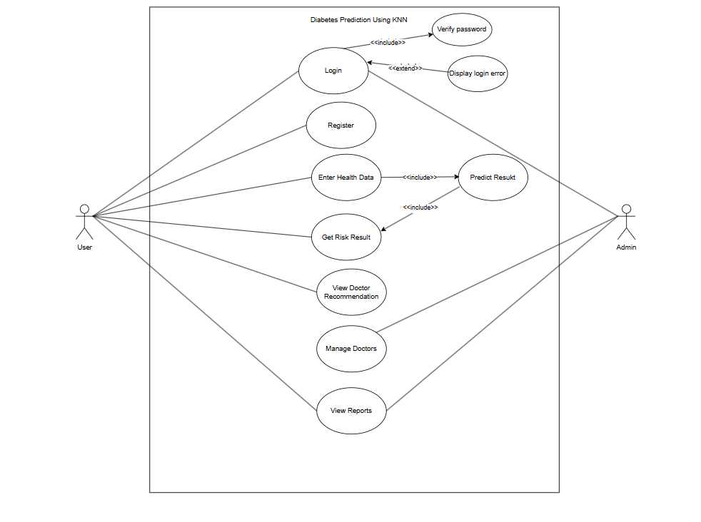
Use Case Diagram
Figure: Use Case Diagram

Slide 5
Algorithm used: K-Nearest Neighbors (KNN)
What is KNN?
KNN stands for K-Nearest Neighbors
It is a supervised machine learning algorithm used for classification and regression
How it Works ?
Calculates distance between new data point and all training examples
Selects K number of closest neighbors
Assigns class based on majority vote of those neighbors

Slide 6
How KNN Works in Diabetes Prediction System ?
Calculates distance between input patient data and all training samples using Manhattan distance metric
Identifies k=19 nearest neighbors (most similar patients)
Assigns class (High Risk/Low Risk) based on majority voting among neighbors

Slide 7
Result Analysis
Dataset Used
PIMA Indians Diabetes Database
768 patient records
268 diabetes cases (34.9%), 500 non-diabetes cases (65.1%)
80% training data, 20% testing data
https://www.kaggle.com/datasets/mahmoudhassanmahmoud/diabites-dataset/data
Model Performance Metrics
Metric | Value
Accuracy | 81%
Precision (Diabetes Class) | 70%
Recall (Diabetes Class) | 64%
F1-Score (Diabetes Class) | 67%

Slide 8
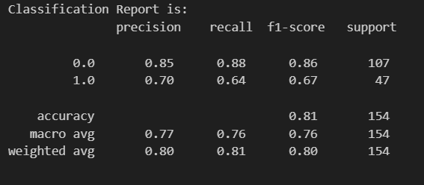
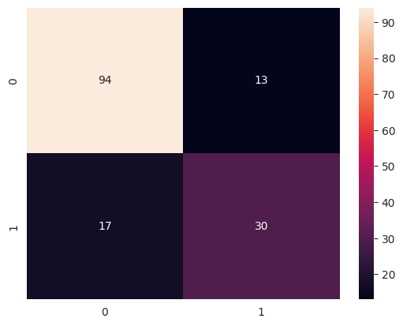

Slide 9
Confusion Matrix Summary
True Negatives: Correctly identified non-diabetic patients
True Positives: Correctly identified diabetic patients
False Positives: Non-diabetic incorrectly labeled as diabetic
False Negatives: Diabetic incorrectly labeled as non-diabetic
Optimal Hyperparameters Found
k Value: 19 neighbors
Distance Metric: Manhattan (p=1)
Cross-validation F1 Score: 0.645

Slide 10
Conclusion
The system successfully predicts diabetes risk using KNN algorithm with 81% accuracy.
Patients are classified into High Risk or Low Risk categories with personalized doctor recommendations.
The web-based platform is user-friendly, accessible, and supports early detection for preventive healthcare.

Slide 11
DEMO

